Slide 1
Middle School
Curriculum
Guide &
Activity
Chakaia
Booker

Slide 2
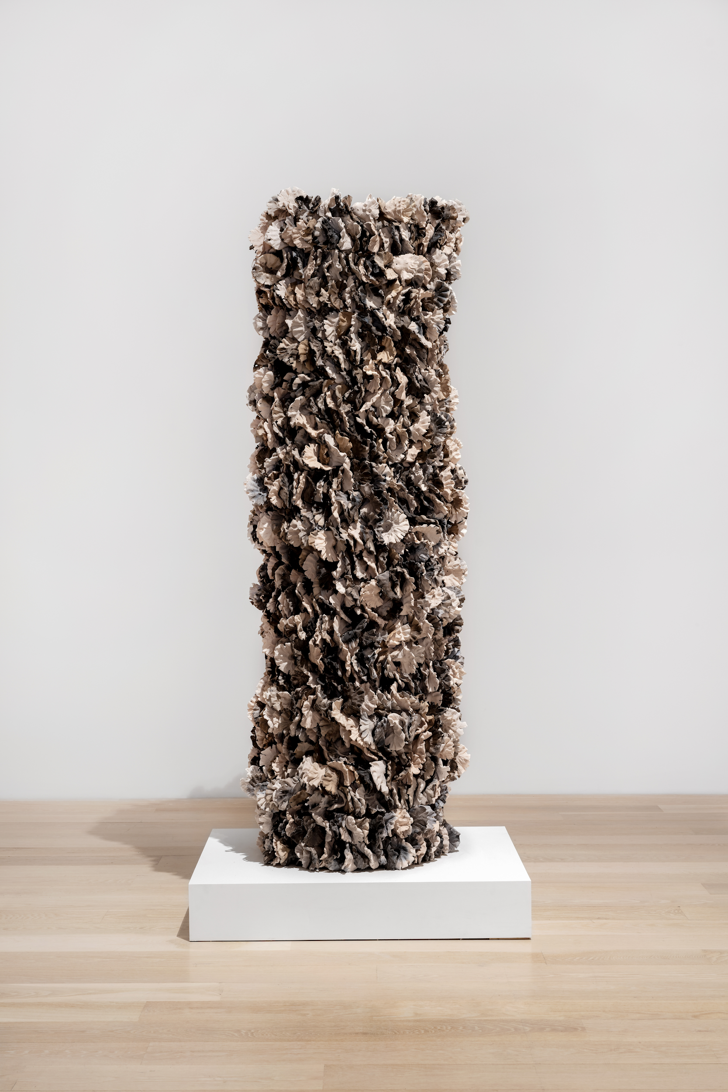
Introduction
In this course, students will explore artist Chakaia Booker's technical artistic practice across various mediums such as wood, metal, rubber, and canvas that will foster imagination, encourage innovation and creative risk-taking.

Slide 3
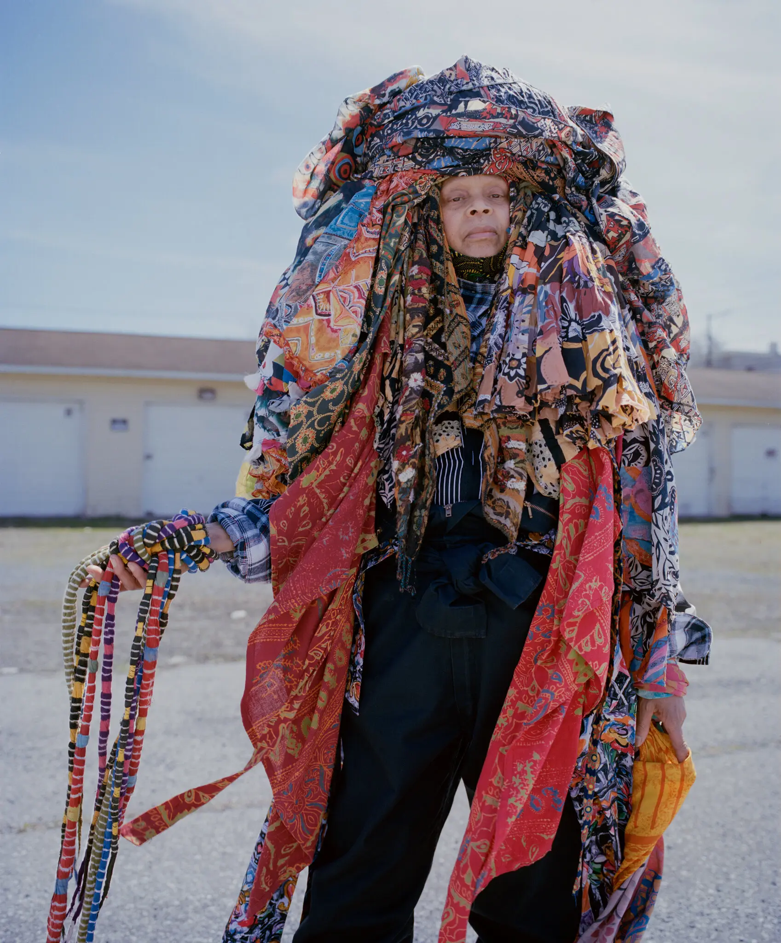
About the Artist
Chakaia Booker is an internationally renowned and widely collected American sculptor known for creating monumental, abstract works for both the gallery and outdoor public spaces. Born in 1953 in Newark, New Jersey and raised in neighboring East Orange, NJ, Booker learned to sew from her grandmother, aunt, and sister. Fixing, repairing, and manipulating materials early in life was foundational to Booker’s later approach to wearable art, ceramics, and sculpture, specifically with the use of pattern, repetition, and modular construction. Beginning in the 1980s, Booker created wearable sculptures which she could place herself inside and utilize as clothing. “The wearable garment sculpture was about getting energy and feeling from a desired design.” In the early 1990s, Booker began to create large outdoor sculptures from stainless steel and discarded materials found at construction sites, including rubber tires, a medium in which she continues to work. Many of her experimental work is made out of bronze, ceramic, and plastic, and acrylic painted on wood, canvas, and paper.

Slide 4
About the Artist
The exhibition features a large range of Booker’s sculptures, which are twisted and woven into totems, monuments, environments, and figures.
Since 1993, she has created a striking, beautiful, and political signature style, assembling cast-off tires into monumental landscapes. Tire tread patterns in her work may also refer to elements of African culture, including scarification, body painting, and traditional textiles.
“When you use any discarded material, it always comes with its own history: it has the history of the manufacturer who produced the product, it has the history of person who utilized it, and what happened to it along the way through its travels. It could then collect things like paint or dirt or stone or glass or anything, and once I’m able to utilize the material, then all of this is information that’s in the actual piece.”

Slide 5
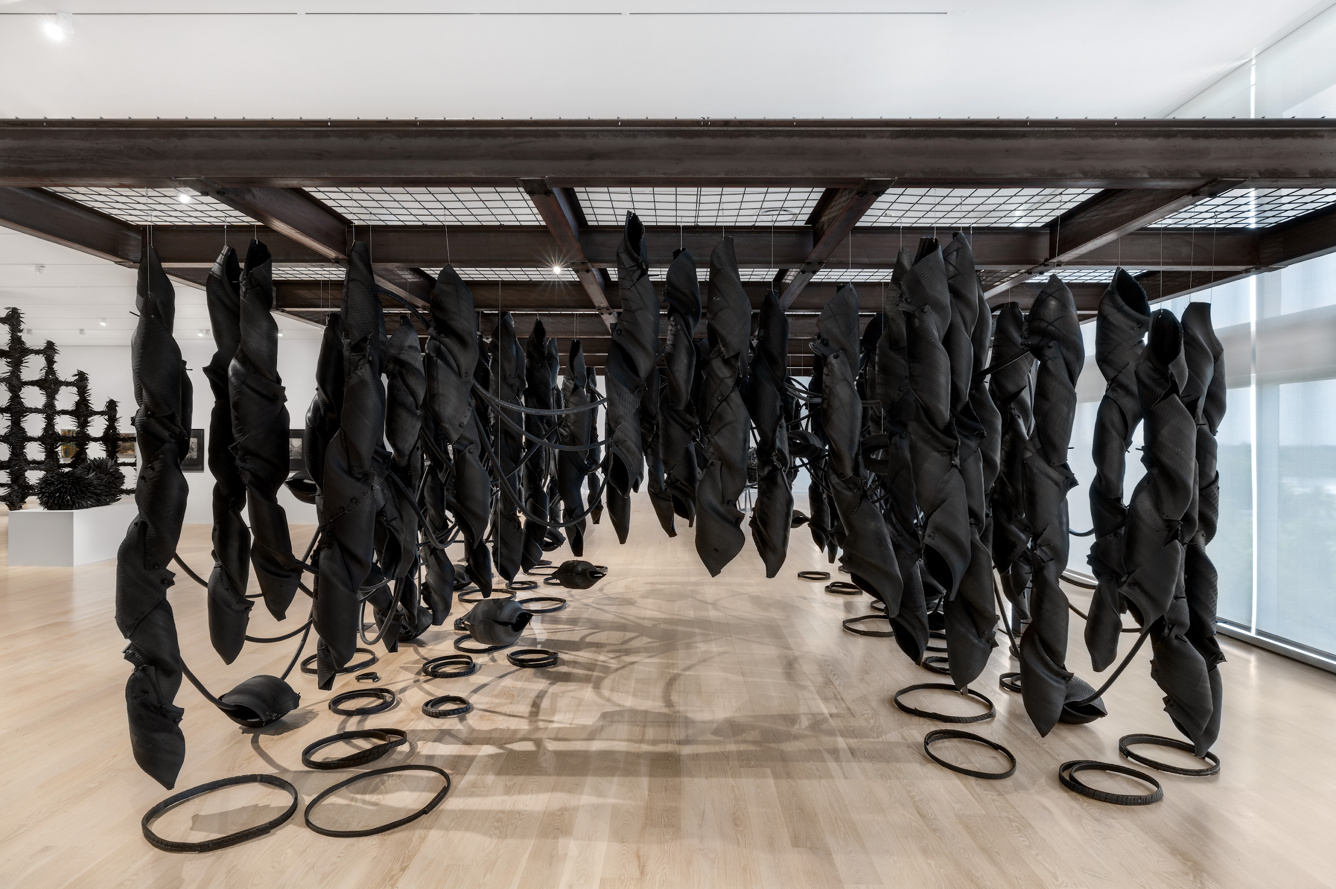

Slide 6
Essential Questions
Discuss the Chakaia Booker quote in this curriculum with students. Have some manufactured objects on hand to discuss in relationship with the quote. Show students the video Chakaia Booker on the State of the Arts, 2003.
How does an artist’s personal history impact their art?
What can you tell about an object by looking at it? What do you wonder that might not be apparent?
If it’s a manufactured object, what might a designer need to have thought about to make it?

Slide 8
Inquiry Questions
What visual qualities are there in Booker’s art? Consider elements and principles of design.
How does her art connect with growing up in Newark, NJ?
Let’s look at this item. [The teacher holds up an object.] How do you think it was made? How do you know? What is its history? If it had a different shape, would it still work? If this object was a work of art, what elements and principles of design do you think were considered by the industrial designer? How would you describe this object to an alien from outer space who has no such need for the item (and little frame of reference)?

Slide 9
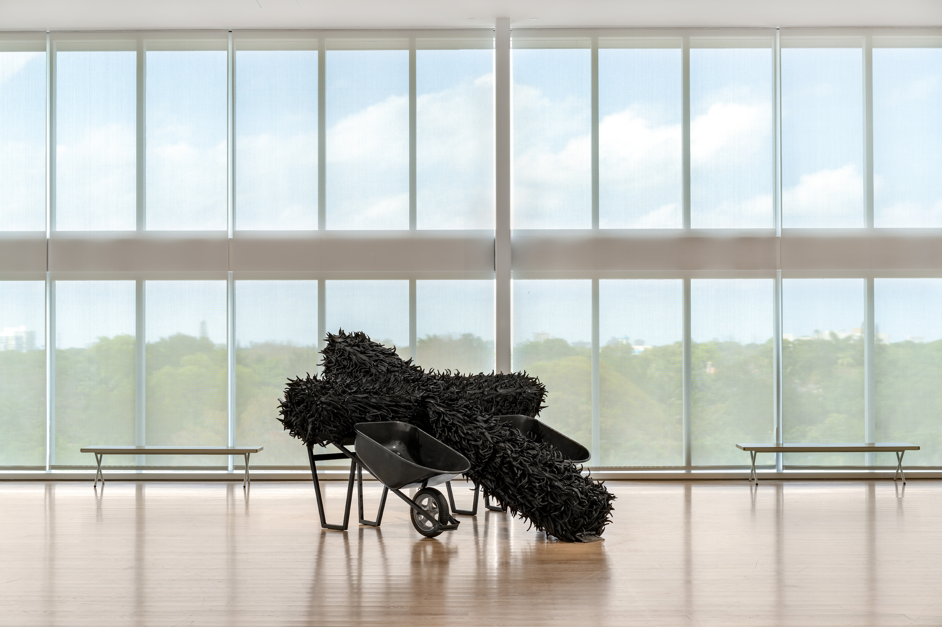

Slide 10
Activity 1
Students will be able to use printmaking techniques to create prints with patterns and use them to construct wearable sculpture inspired by Booker’s wearable art.
Materials
} Printmaking materials in conjunction with the technique you will be teaching.
(Linoleum cuts could be an option) Linoleum cut materials: carving tools, a piece of linoleum per student, barren, brayer, bench hook, ink. Stamping is another method of printmaking. For stamping, students can stamp a variety of objects such as paper cups, corks, small pieces of cut cardboard or its edges, etc. In acrylic or liquid tempera paint and then press them onto colored paper or printmaking paper.
} Colored paper (optional)
{ Scissors
} Glue stick or colored tape
{ Measuring tape (optional)

Slide 11
Activity 1 | Steps
Class 1:
Review the course presentation and use the essential questions and discussion prompts to analyze Booker’s work as a class.
Watch the video Fall 2022 Catalyst Artists-in-Residence Chakaia Booker and Phil Sanders_McColl Center_ video which shows Booker using the techniques of printmaking and collage and Chakaia Booker on the State of the Arts, 2003 in connection to wearable art/sculpture.
Explain the way prints can make multiple images. Show students examples of the type of printmaking they’ll be doing.
Students sketch pattern ideas for prints and discuss their concepts.
Class 2:
Review relevant printmaking terms to the technique the students will be using as you show materials and demonstrate the technique. Explain where prints will be stored and clean up procedures.
Tell students how many prints to make, explaining they will be using the prints in conjunction with colored paper (optional) to make wearable sculpture.
Student work time.
Student clean up.

Slide 12
Activity 1 | Steps
Class 3:
Demonstrate creating a wearable sculpture by cutting and forming paper prints with glue or colored tape.
Ask students to share ideas for items that they could make.
Students sketch ideas for their wearable sculpture, keeping in mind the size and quantity of the prints they have to work with.
Students construct their sculpture. Optional: use a tape measure to measure their body and paper for an accurate fit. This could be facilitated with images of clothes patterns so that students understand the way clothes are designed to fit the body in sections of cloth shapes.
Peer reviews of works in progress can be facilitated and/or a final review.
Extension
Students sketch each other wearing their art or put on a wearable sculpture fashion show for another class. This lesson could be followed by a fashion design unit or further explorations in printmaking.

Slide 13
Activity 2
Chakaia Booker uses recycled materials to create large sculptures. Students will create a sculptural form from found and recycled materials inspired by the artist's work.
Materials
} Hot glue gun
{ Hot glue sticks
} Construction paper
{ Tape
} Permanent markers or spray paint
{ Scissors
} Cardboard (Optional)
{ Water bottles (Optional)
} Plastic bottle caps (Optional)
{ Egg cartons (Optional)
} Bubble wrap (Optional)
{ Soda cans (Optional)
} Milk jugs (Optional)
{ Plastic bags (Optional)

Slide 14
Activity 2 | Steps
Read through all the steps before beginning.
Collect and prepare materials, making sure your water bottles and other items are washed and cleaned. You can consider removing the labels so the focus is on the material being used rather than brands. Teachers may need to pre-cut materials or have an assistant(s) in the classroom.
Decide whether students will paint the recycled pieces separately before assembling or after the piece is complete and assembled. This will affect how the finished piece looks. The pieces can be spray painted individually in different colors or the final piece can be spray painted one solid color. If using permanent markers, the pieces should be colored separately before assembling.
Show students the Chakaia Booker presentation on ICA Miami’s website in conjunction with this curriculum and facilitate a class discussion using the essential questions and inquiry questions/discussion prompts.
Students select recyclables considering shape/form, color, size, and texture.
Students cut the materials they are able to cut independently. Note: many recyclables need to be cut with sharp industrial scissors or other such tools that should only be handled by an adult.
Have a system in place to take turns using glue guns. This can be done by seeing who is ready to glue first or drawing names. Have an activity such as a sketchbook prompt ready for students who are waiting (see extensions). One example is for students to investigate form and texture by drawing a still life arrangement of the materials.
Review hot glue gun safety. Never touch the tip or the glue. Use a small amount of glue per piece.

Slide 15
Activity 2 | Steps
Demonstrate using the glue gun, creating a sculpture with repetition by using some small pieces of materials multiple times in the piece to create a new form.
Students assemble their sculptures.
Make adjustments to the pieces, adding more if necessary to make the sculpture balanced.
Organize a time for peer feedback/suggestions during the working process and/or do a final critique. This could involve students who are waiting to glue or are finished gluing.
Extension
Students can investigate form and texture by drawing a still life arrangement of the materials.
In subsequent classes, students can draw their own sculpture or those of their classmates, learning observational drawing techniques including contour drawing and shading (value).
Students can create drawings in colored pencil or watercolor with pen (after the paint dries), imagining their finished sculpture in an outdoor sculpture garden with neighboring sculptures (perhaps inspired by those of their peers or famous artists). Show students pictures of sculpture gardens like ICA Miami’s, the MOMA’s, or Grounds for Sculpture.

