Slide 1
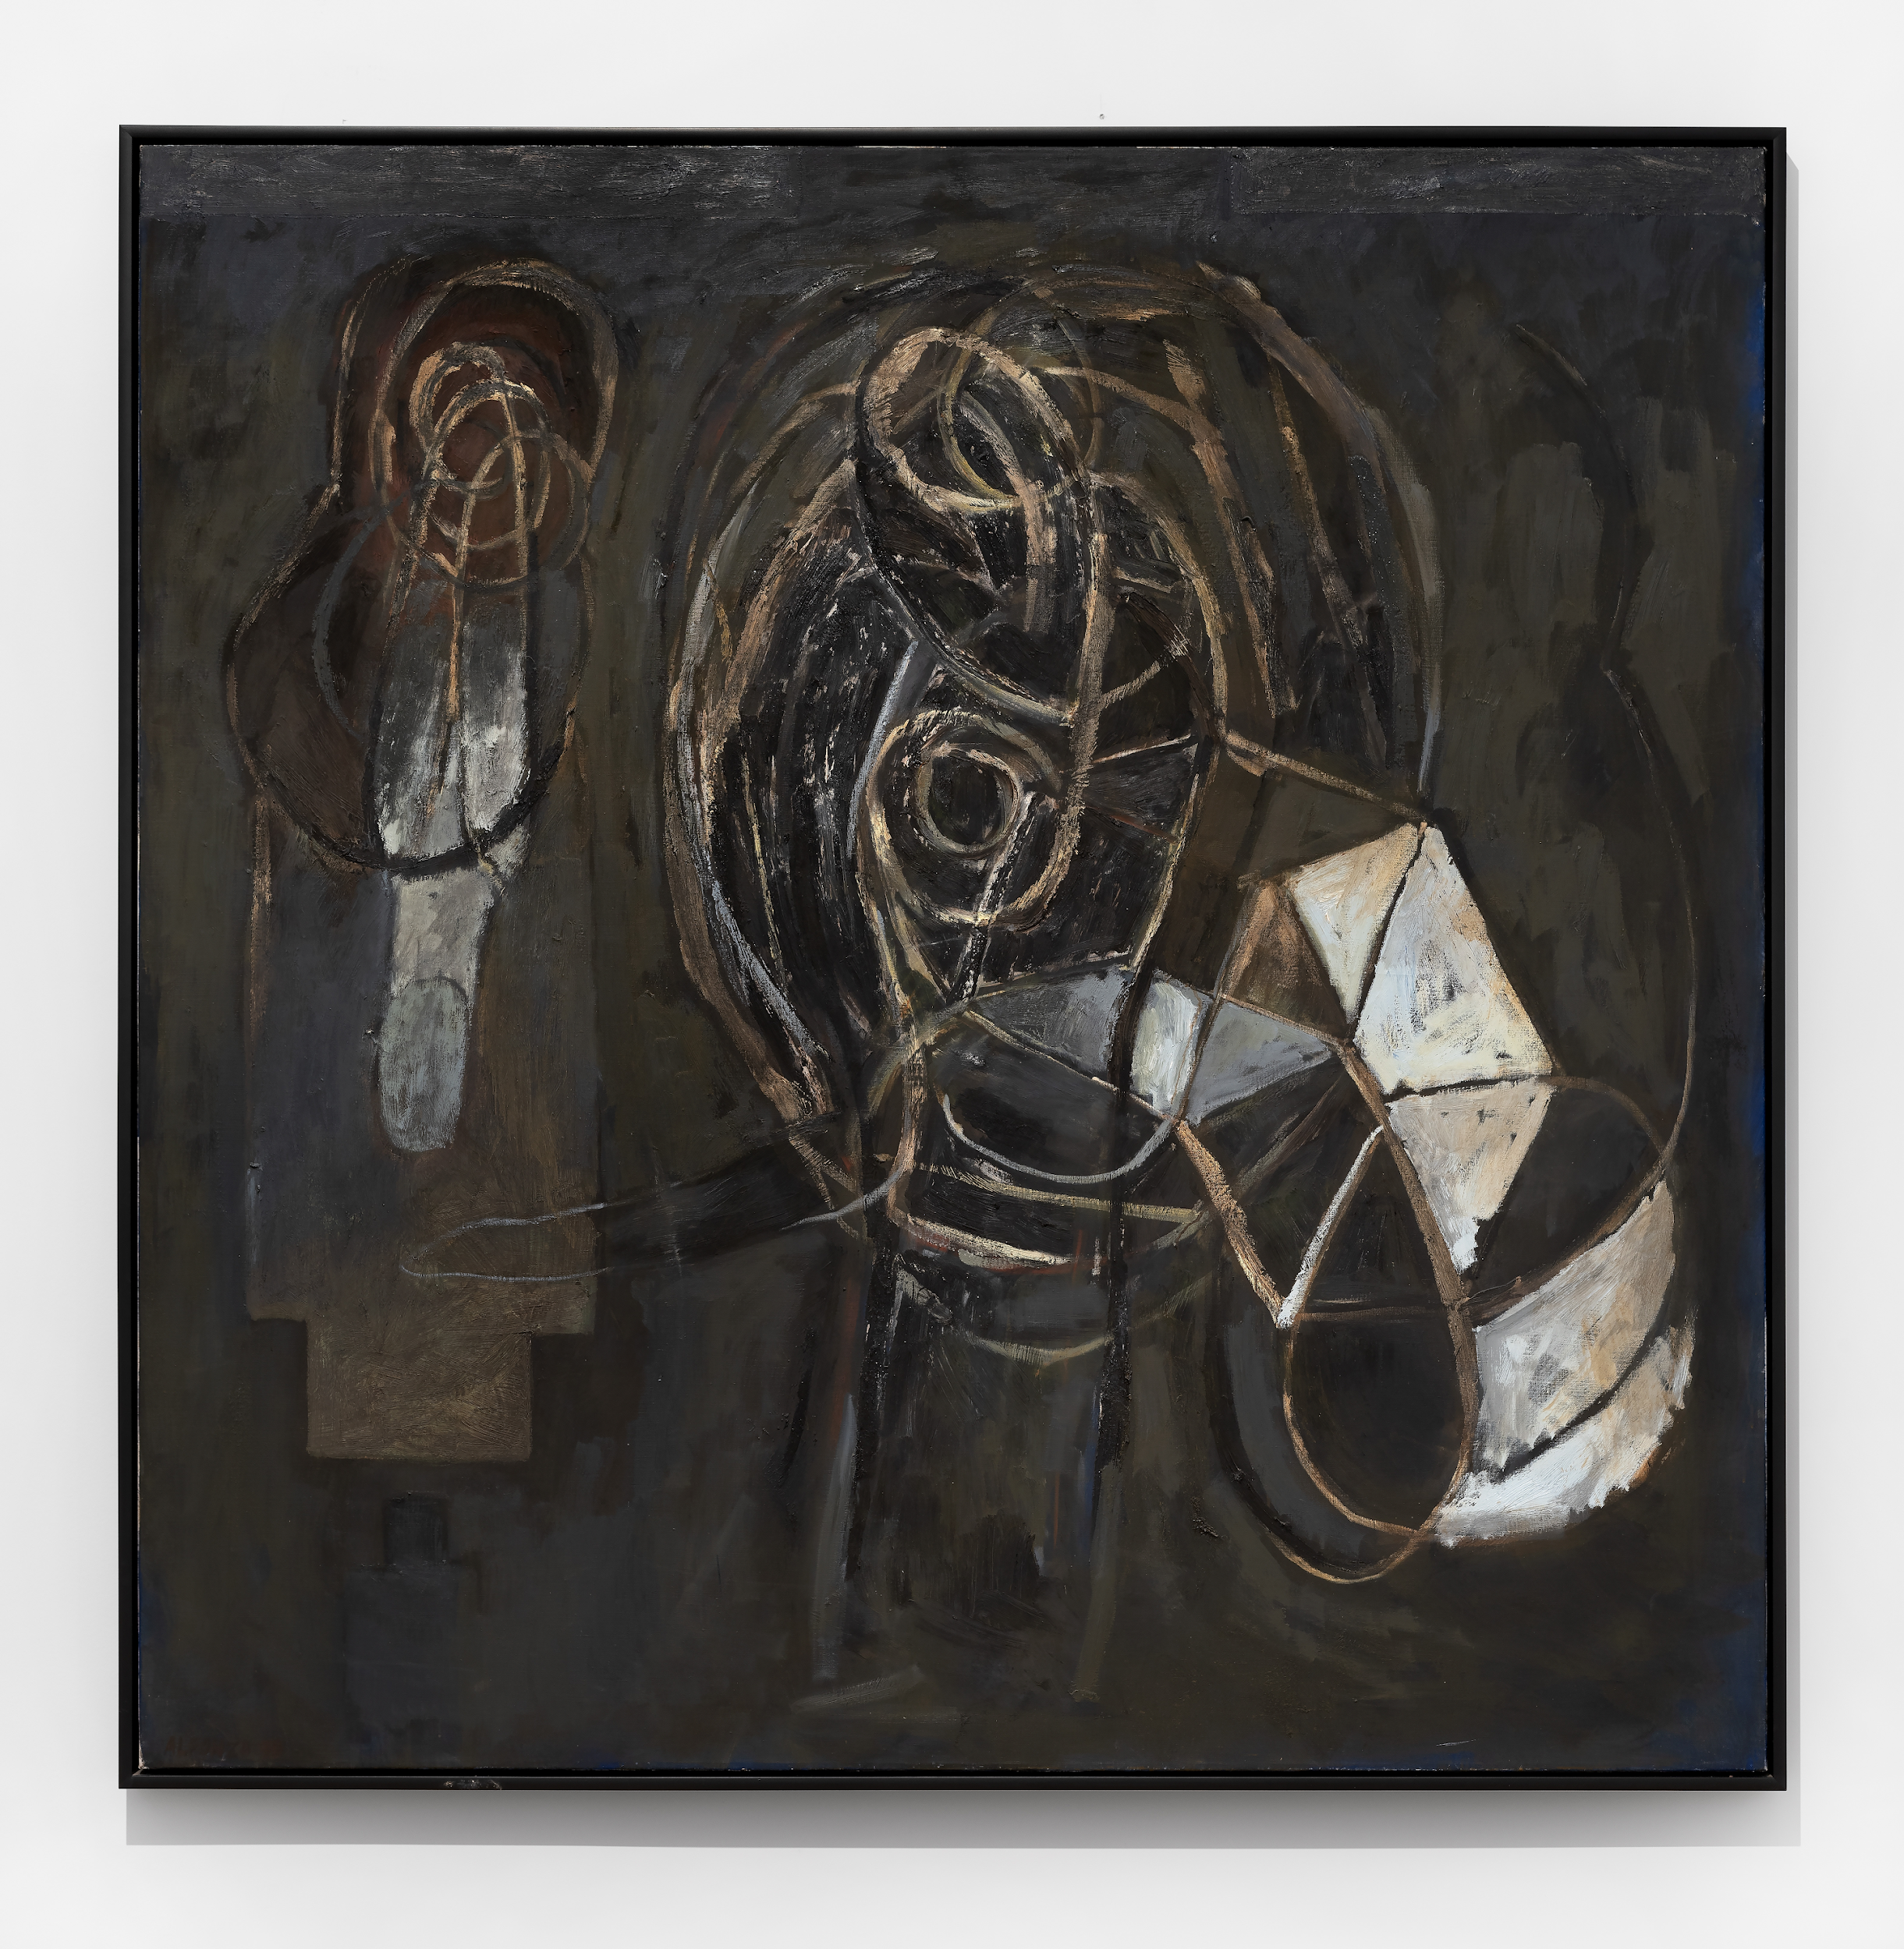
High School
Curriculum
Guide &
Activity
Carlos
Alfonzo

Slide 2
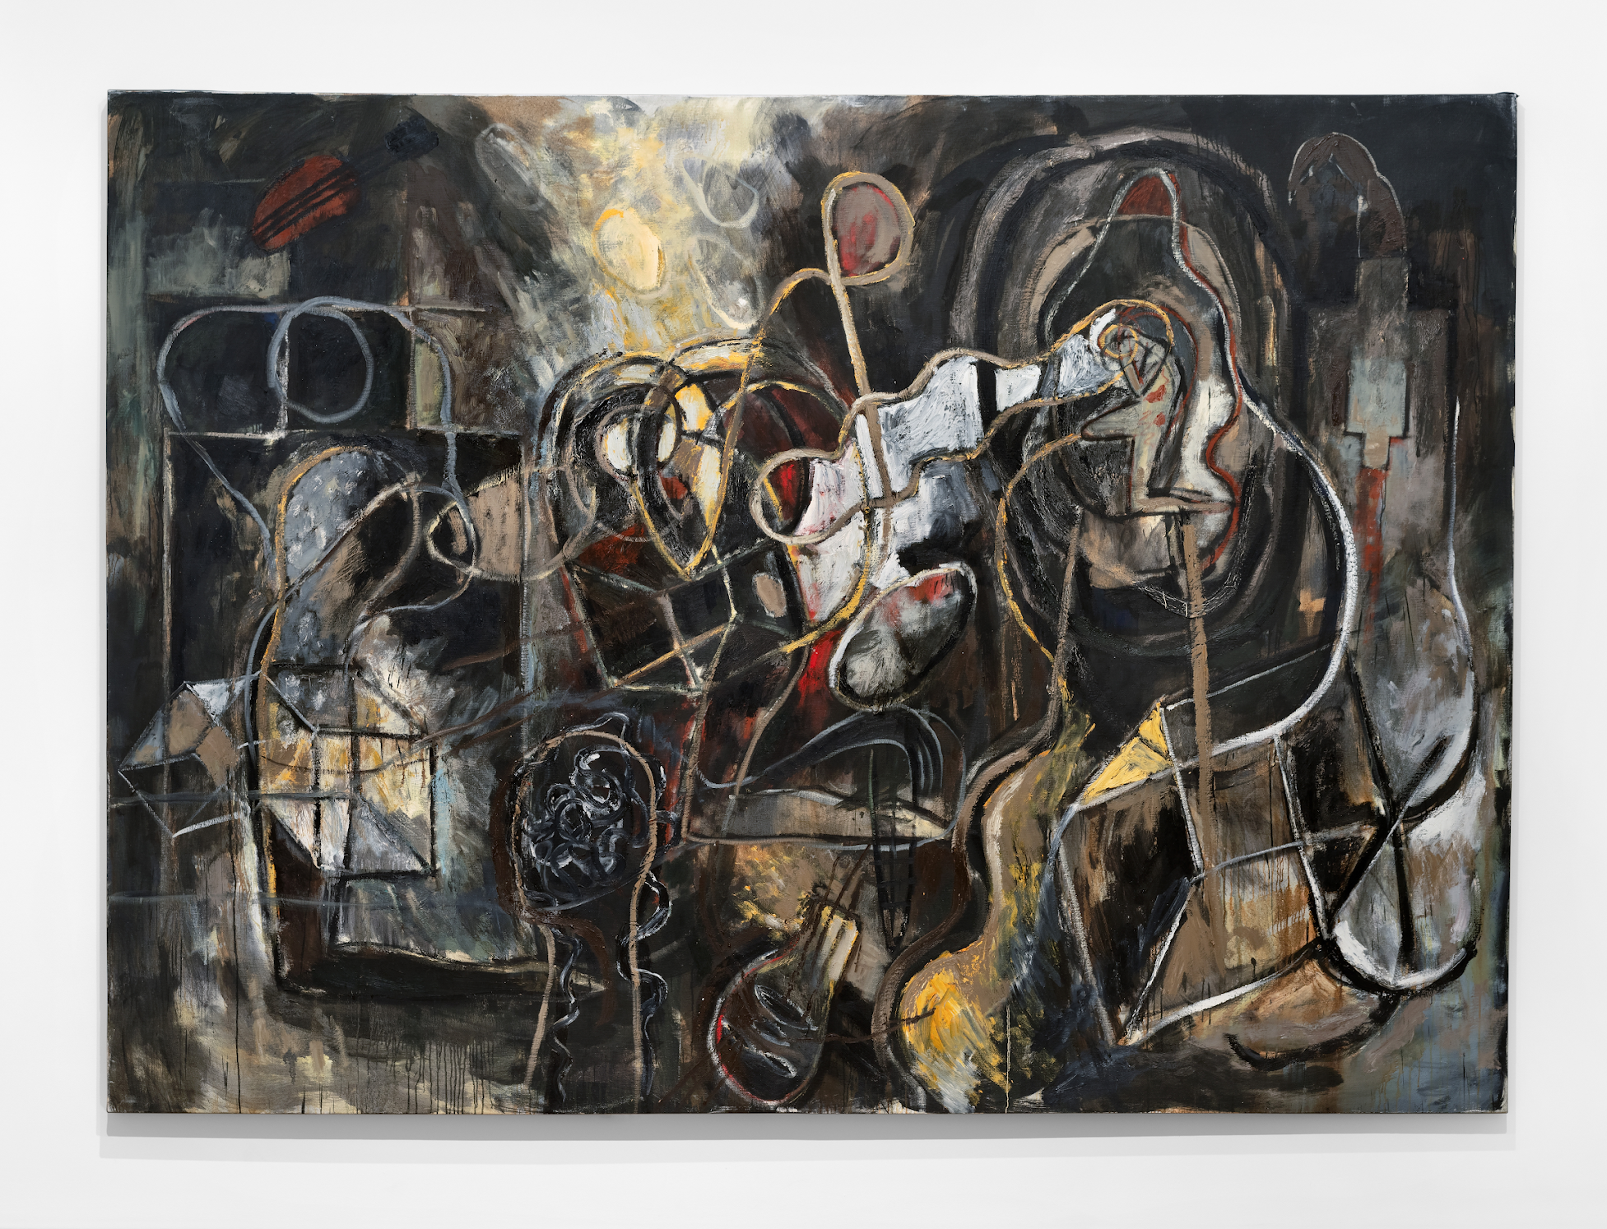
Introduction
In this course, students will explore how painter Carlos Alfonzo uses his expressionist style of painting to create narratives that reference cultural and semantic systems, Cuban Santeria and other religious practices.
By learning about Alfonzo’s work and expressionist approach to artmaking, students delve into themes of resilience and reflective narration through character creation.

Slide 3
About the Artist
Carlos Alfonzo was born in Havana, Cuba, in 1950. He received a degree in art from Academia San Alejandro in Cuba and later attended the University of Havana where he received a degree in art history in 1977.
An active participant in Cuba’s artistic community during the 1970s, Alfonzo grew increasingly disenchanted with the Revolution, frustrated by travel restrictions and pervasive homophobia. In the short decade between his departure from Cuba during the Mariel boatlift of 1980 and his untimely death in 1991 from AIDS-related complications, he generated a consistent body of work that reinvigorated expressionist painting with unexpected references to many cultural and semantic systems, including Cuban Santería and other religious practices. Although most of Alfonzo’s production involves highly colorful and dynamic compositions, during the last year of his life he radically reduced his color palette, engaging in a concentrated deployment of pictorial markings. The large, somber paintings of this final period pivot on a surprising range of emotional tones and sophisticated dialogue with art history. Alfonzo has emerged over the last twenty years as one of the preeminent painters of the 1980s.

Slide 4
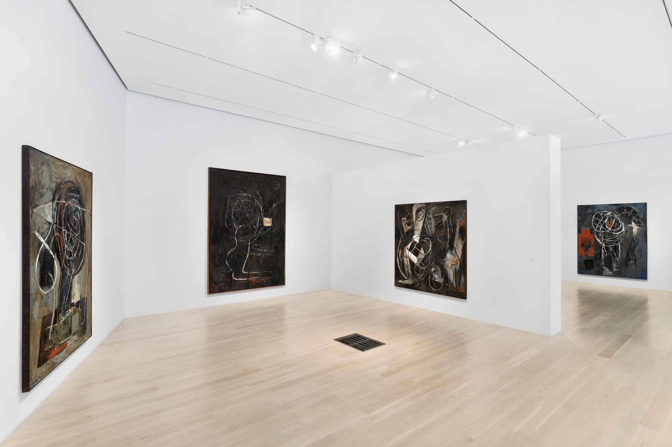

Slide 5
Essential Questions
How can personal circumstances affect an artist’s work?
How does culture affect an individual’s beliefs?
In what ways can an artist’s work change?

Slide 7
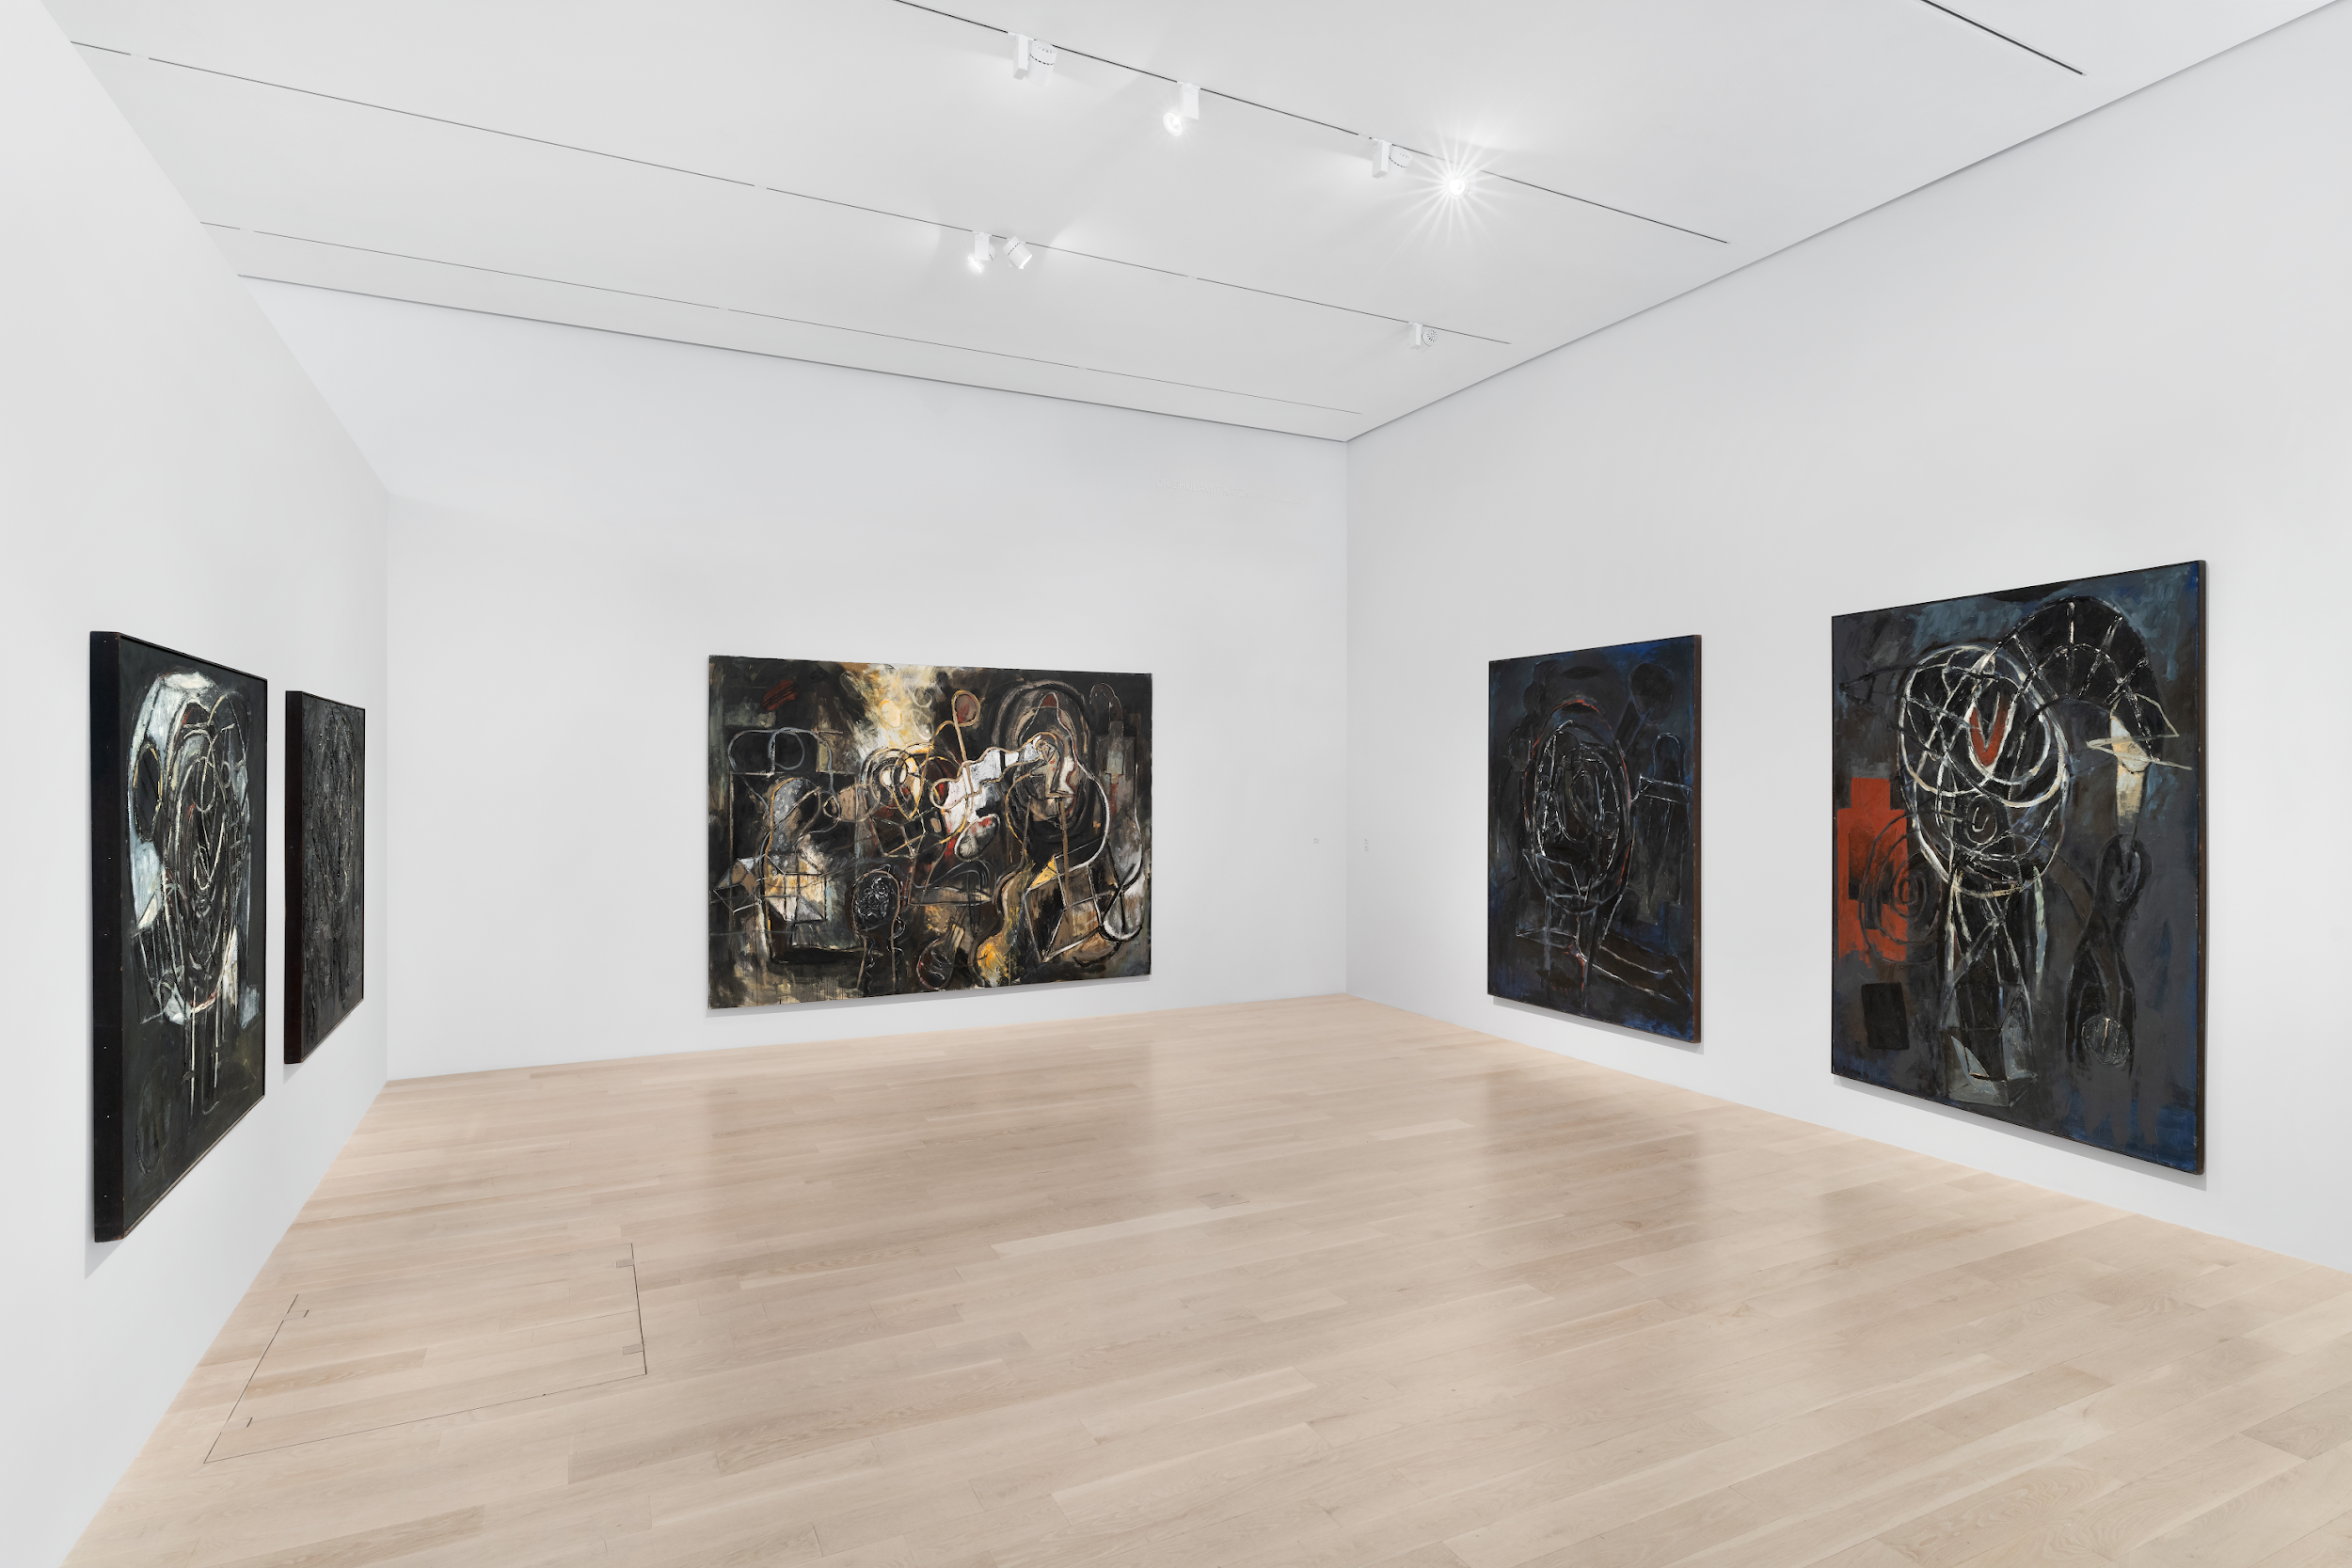
Inquiry Questions
What are examples of things people believe in your family, community, state, and country?
What are some challenges for your generation?
What materials, processes or subjects for art make you curious?
What arrangements of shapes, lines, and other elements and principles of design does Carlos Alfonzo use create strong compositions? Compare and contrast two or more works. [This will help students when creating their drawings.]

Slide 9
Activity
Students create drawings depicting a narrative that reflects an aspect of themselves and the culture or environment in which they live. They can choose to work with Carlos Alfonzo’s color palette or choose their own color combinations. Color choices should reflect the content, meaning, and mode of their work.
Materials
} Black cardstock
{ Neutral palette of oil pastels (grays/browns/white/black) like Carlos Alfonzo as well as oil pastels in
all colors.
} Pencil and eraser for signatures
{ Optional white paper for quick sketches (not detailed because oil pastels lend themselves to more
expressionistic, large marks).

Slide 10
Activity | Steps
Help students consider different ways in which they can create a visual narrative (imagery) to express one or two challenges and beliefs that are important to them.
Students lightly sketch compositions and make adjustments by drawing and erasing. Limit details; large areas are best when working with oil pastels.
Students choose their color palettes and create their drawings.
Prior to a class discussion about the work, put a piece of paper and a pencil next to each student’s drawing. Tell students they will write a comment on three people’s papers about their work and they should make sure that every artwork has at least two comments. They can choose to comment on the artwork’s concept, color palette, or composition and explain their observation.
Have 3-5 students volunteer to talk about their work and answer questions from the class (it isn’t necessary for every student to share, but they can if there is time and they would like to). They should focus on the same criteria as the comments by explaining their beliefs, color choices, and compositional strategies.

Slide 11
Activity | Extension
Students write artist statements to accompany their artwork.
Students could interview a family member or someone they know about their beliefs and challenges and make an artwork in the medium of their choice in response.
Students could create a documentary style video in which they interview others about their beliefs and challenges.
Students could do this lesson in the medium of photomontage or digital photomontage using photos from the internet.
Students could write a paragraph about someone they admire, their struggles and beliefs, and create a portrait to go with it.
Students could work as a class to make a zine using photos, writing, and drawing to express themselves regarding issues in their school and community.

