Slide 1
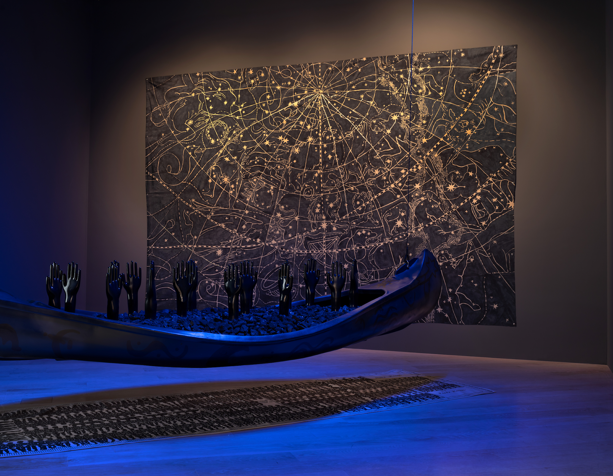
Middle School
Curriculum
Guide &
Activity
Betye
Saar

Slide 2
Introduction
In this course, students will discuss the work of assemblage artist Betye Saar who reframes image-making outside of male-dominated Western painting traditions while honoring the creative labor of women standing up against social and political ills and environmental destruction. Saar’s installations expand on her celebrated repertoire and o er broadened insight into ritual, spirituality, and cosmologies in relation to the African American experience and the African diaspora. During the initial discussion, proposed questions will draw upon students’ critical thinking skills to make connections between Betye Saar’s artistic process, use of materials and the narratives in her work.

Slide 3
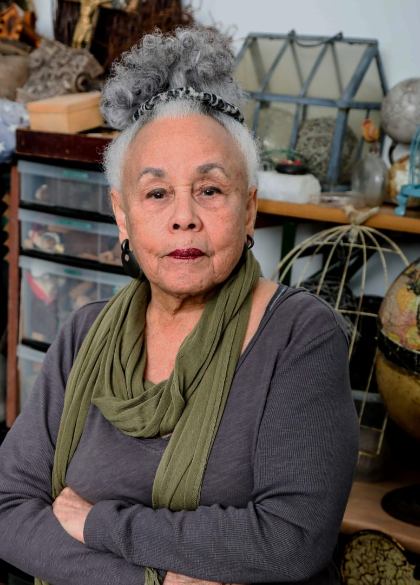
About the Artist
Rooted in the artist’s critical focus on Black identity and intersectional feminism as well as the racialized and gendered connotations of found objects, Saar’s installations expand on her celebrated repertoire and o er broadened insight into ritual, spirituality, and cosmologies in relation to the African American
experience and the African diaspora.
Boldly addressing questions of race and gender in her art and activism, Betye Saar (b. 1926, Los Angeles) has been a pioneer of readymade art on the West Coast and Black feminist art in the United States since the 1960s. Her revolutionary work has been exhibited in solo and group exhibitions throughout the United States and around the world, including, most recently, the retrospective “Betye Saar: Still Tickin’” at the Scottsdale Museum of Contemporary Art, Arizona, and Het Domein, Sittard, The Netherlands; the group show “We Wanted a Revolution: Black Radical Women, 1965–85” at the Brooklyn Museum, New York; and the monumental traveling group show

Slide 4
About the Artist
“Soul of a Nation: Art in the Age of Black Power” at the Tate Modern, London; Crystal Bridges Museum of American Art, Bentonville, Arkansas; Brooklyn Museum; The Broad, Los Angeles; and the M. H. de Young Memorial Museum, Fine Arts, Museums of San Francisco.
“I am intrigued with combining the remnant of memories, fragments of relics and ordinary objects, with the components of technology. It's a way of delving into the past and reaching into the future simultaneously.”
“I make my art in silence,” Betye Saar has said. “The materials conjure ideas. The ideas conjure images. The images conjure art. The art conjures feelings. The feelings are the goal.”

Slide 5
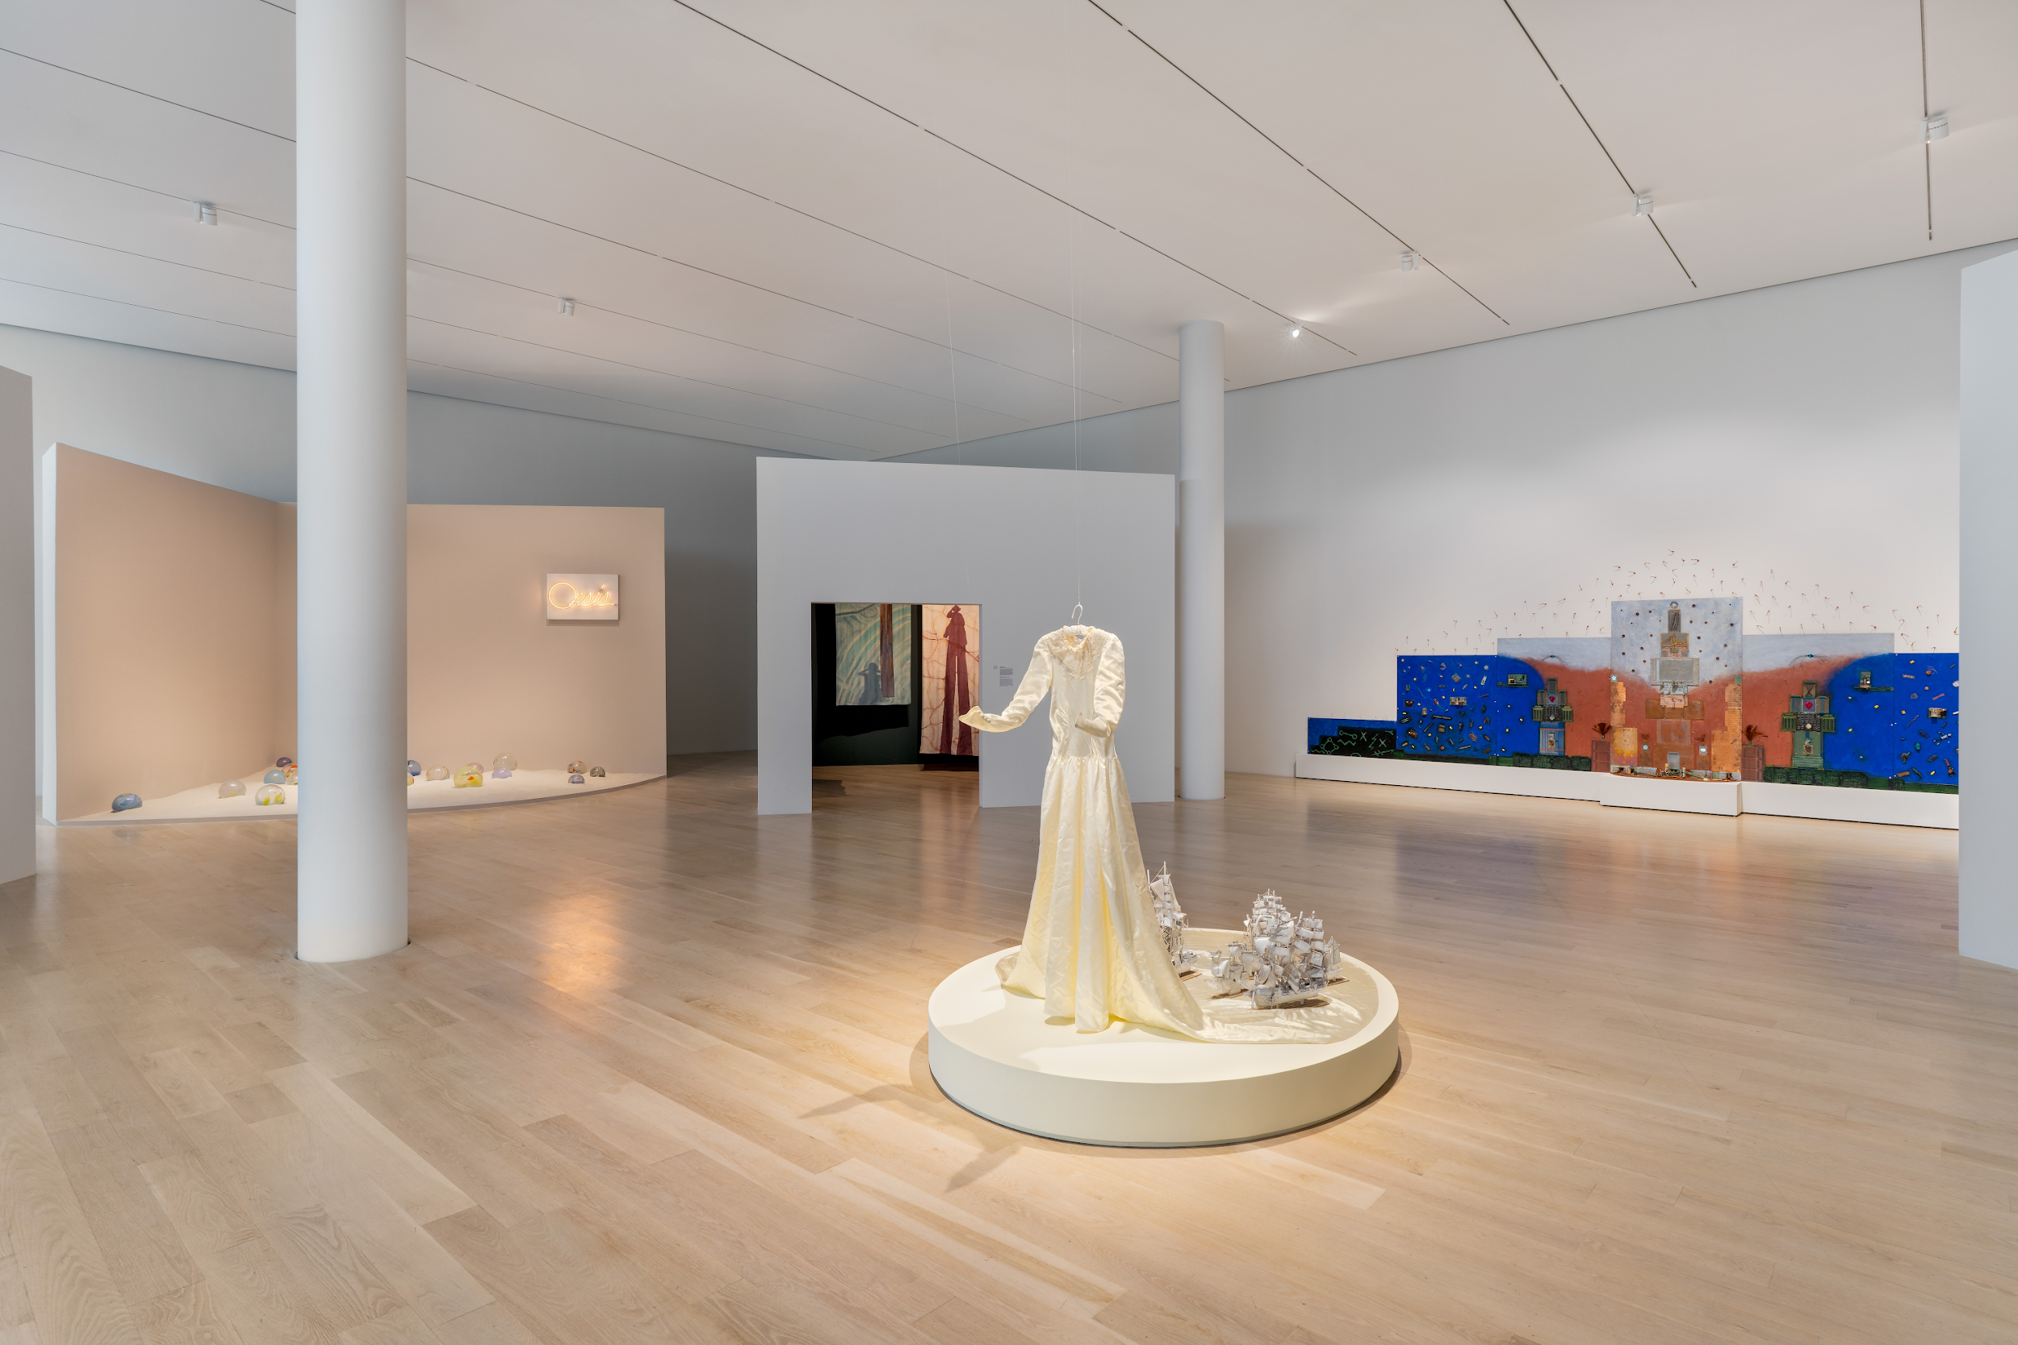

Slide 6
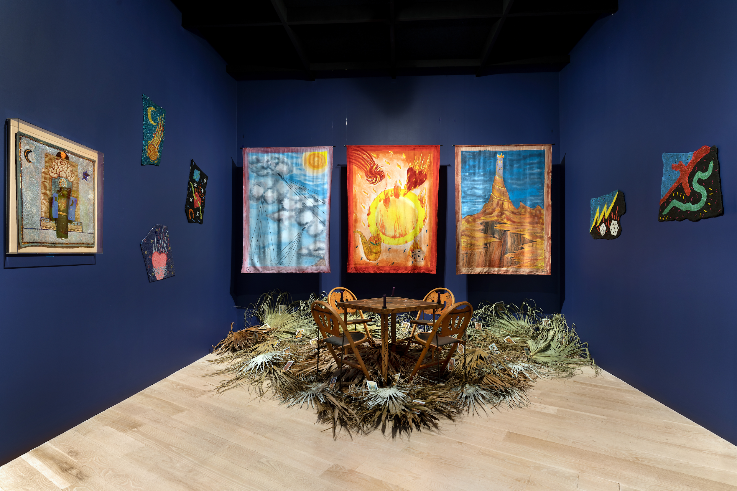
Essential Questions
What are some similarities and differences between the experience of learning from an artwork vs. a story?
How can combining pictures, objects, and symbols develop meaning?

Slide 8
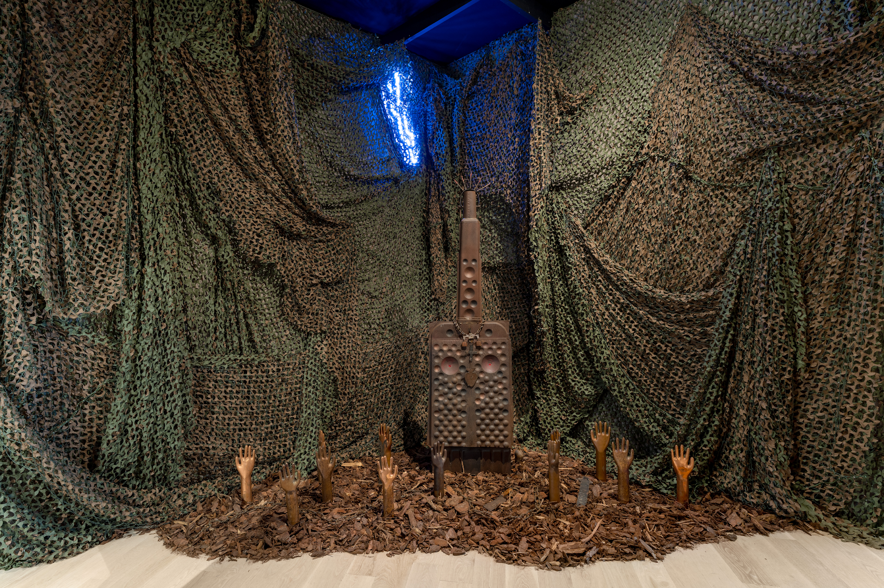
Inquiry Questions
What do you notice about Betye Saar’s work?
How would you describe it to someone who wasn’t looking at it?
What do you observe in Betye Saar’s work that reflects the African diaspora or African American experience?
What are myths for?
What do you relate to or wonder about when looking at Saar’s work?
What is meaningful to you?

Slide 10
Activity 1
Students create mixed media assemblages considering composition, elements and principles of design, and a theme that is personally meaningful.
Materials
} Large roll of paper
{ Heavy cardstock paper (plain or colored)
} A cardboard box
{ Markers
} Glue stick
{ Hot glue gun and hot glue sticks
} Scissors
{ Pencil
} Eraser
{ Washed and clean recyclables with labels removed
} Optional: magazines, plants and flowers

Slide 11
Activity 1 | Steps
Review the presentation accompanying this curriculum and watch the video Studio Tour with Betye Saar from the LA Times. Discuss the essential questions and discussion prompts in small groups and as a class. In each small group, one student should take notes.
Choose a topic that is meaningful to you. Examples could include family, a favorite task, a place you like to visit, something or someone inspiring to you.
Decide if you are going to draw pictures by coloring cardstock with markers and/or cut out photos from magazines. Another option is printing photos.
Cut them and have them ready before setting up the glue gun.
Select objects by thinking about shape, form, color, texture, and scale. When thinking about scale, consider the size of one object in relationship to another.
Decide how the cardboard box will be oriented.
Glue gun safety: don’t touch the tip or the hot glue itself. Use small amounts. Glue onto the box and then attach the piece rather than putting glue on small pieces that you’re holding.
Glue the pieces into the cardboard box in a composition that looks interesting to you. You can also glue things to its top and sides and arrange unglued objects in the front.
Ask others for feedback before deciding the piece is completely finished.

Slide 12
Activity 1 | Extension
Individual artworks combine to make installation art in the ICA Miami exhibition, Betye Saar: Serious Moonlight. Plan a class art show by creating an art installation from students’ individual artworks. Students work together to decide the arrangement of their works in a given location. Additional objects or collaborative artworks can be incorporated into the installation as well as sound and light.

Slide 13
Activity 2
In this lesson, students will be able to connect their mixed-media assemblage with Saar’s by writing an essay that includes talking points from small group and whole class discussions. Students will compare and contrast their theme with Saar’s. They will describe their artistic process and decision making.
Materials
} Computer or writing paper
{ Pen or pencil
{ Eraser

Slide 14
Activity 2 | Steps
If you didn’t do part one of this curriculum, review the presentation accompanying this curriculum and watch the video, Studio Tour with Betye Saar from the LA Times. Discuss the essential questions and discussion prompts in small groups and as a class.
Students reflect on their class and small group discussions surrounding this course and have access to their notes.
Students brainstorm for their essay by making a list of key points in their creative process including their theme, how they chose their materials, elements and principles of design used, troubleshooting the building and design process, and key points of Saar’s work that relate to theirs or are not like theirs.
Students create an outline.
Students write and submit for teacher and peer feedback.
Students edit and revise.
Extension
Student essays can accompany an exhibition of their work as their artist statements.

